Slide 2
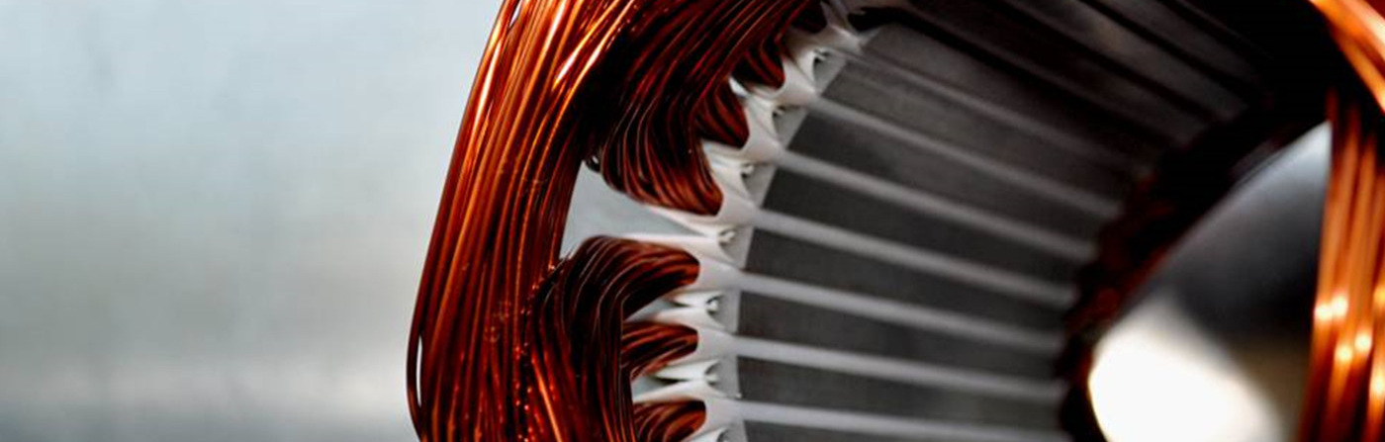
Development of a Parametric Tool for Automated Slot Insulation Insertion in Small-Scale Electric- Motor Stator Production
Alen Sebastian 23221507 (M Sc Electromobility)
Project Thesis Presentation

Slide 3
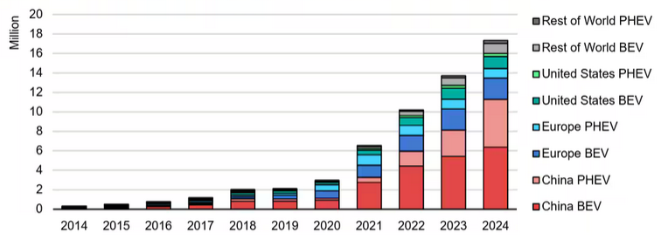
Climate change and CO₂ emissions drive the need for sustainable mobility, leading to a rapid rise in electric vehicle demand.
Climate change & CO₂ emissions → need for sustainable technologies
Transport sector accounts for about 23% of global CO2 emissions
Electrification trend → rapid growth of EVs →surge in electric motor demand
Large-scale production: highly automated
Small-scale/custom production: still manual, especially slot liner insertion
Manual process = time-consuming, inconsistent, costly
Fig 1. Global EV sales [1]

Slide 4
Objective: To Develop a flexible insertion tool to automate slot-liner insertion in small-scale stator manufacturing
Flexible manufacturing
Automated Slot-Liner Insertion
Parametric Tool Design
Process reliability and repeatability
Robotic Integration and validation

Slide 5
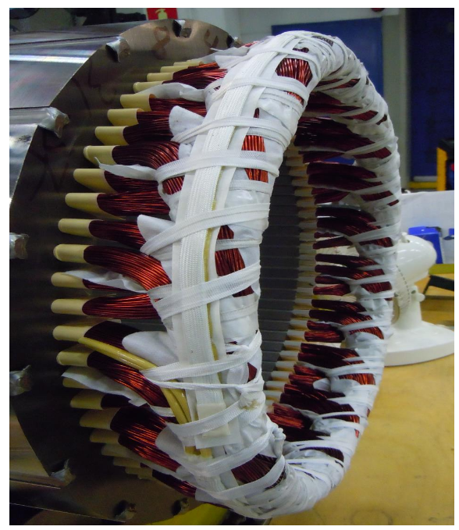
Producing a stator requires a sequence of precise manufacturing steps, ensuring structural integrity, insulation, and electrical reliability.
Key steps in stator manufacture involve:
Core Preparation – Laminated electrical steel sheets are cut, stacked, and bonded to form the stator core.
Insulation Insertion – Slot liners and other insulation elements are placed to isolate windings from the core.
Winding & Interconnection – Copper wires are wound into slots and interconnected (crimping, soldering, welding).
Stabilization & Testing – Resin impregnation improves insulation and thermal performance, followed by electrical tests for quality assurance.
Fig 2. Fully assembled Stator [2]

Slide 6
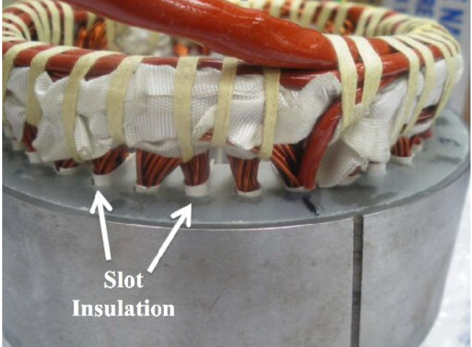
In stator production, slot liners are essential components that ensure proper insulation of the windings and protect against mechanical wear during operation.
Electrical Insulation
Thermal Management
Wear Resistance
Winding Retention
Fig 3. Slot Insulation in a stator [3]

Slide 7
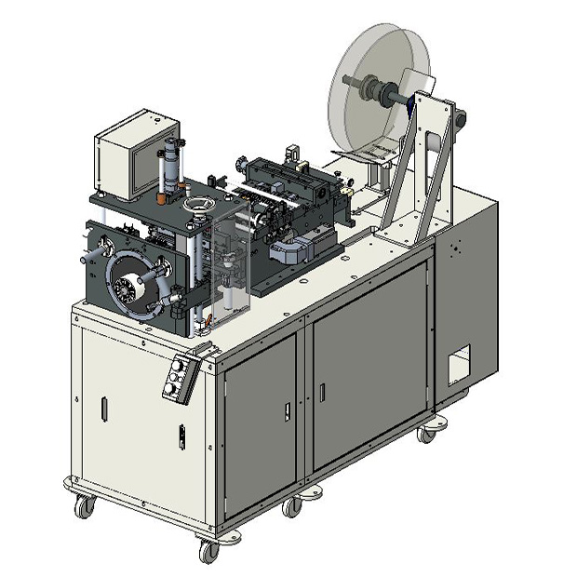
How slot liners are inserted in large scale manufacture such as in the automotive industry:
Large batch manufacture with constant motor size.
High Investment costs.
High speed insertion (3 sleeves per second).
. Fig 4. GMW CS-5E Horizontal Slot Cell Inserter [4]
Not suitable for high variance, low volume production.
Integrated cutting, folding and creasing.

Slide 8
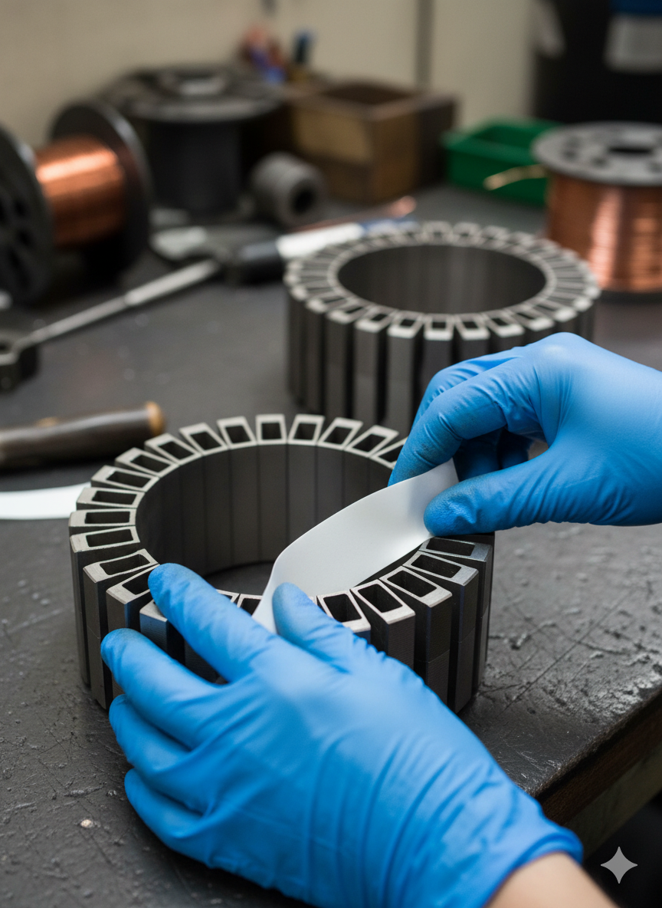
How slot liners are inserted in small scale manufacture such as in aviation or naval industries:
High variance low volume production.
Flexible, low cost.
Insertion is done manually.
Fig 5. Manual insertion of slot liner
Labor intensive, difficult to scale.
Use of jigs, cutting/folding machines.
*AI generated image

Slide 9
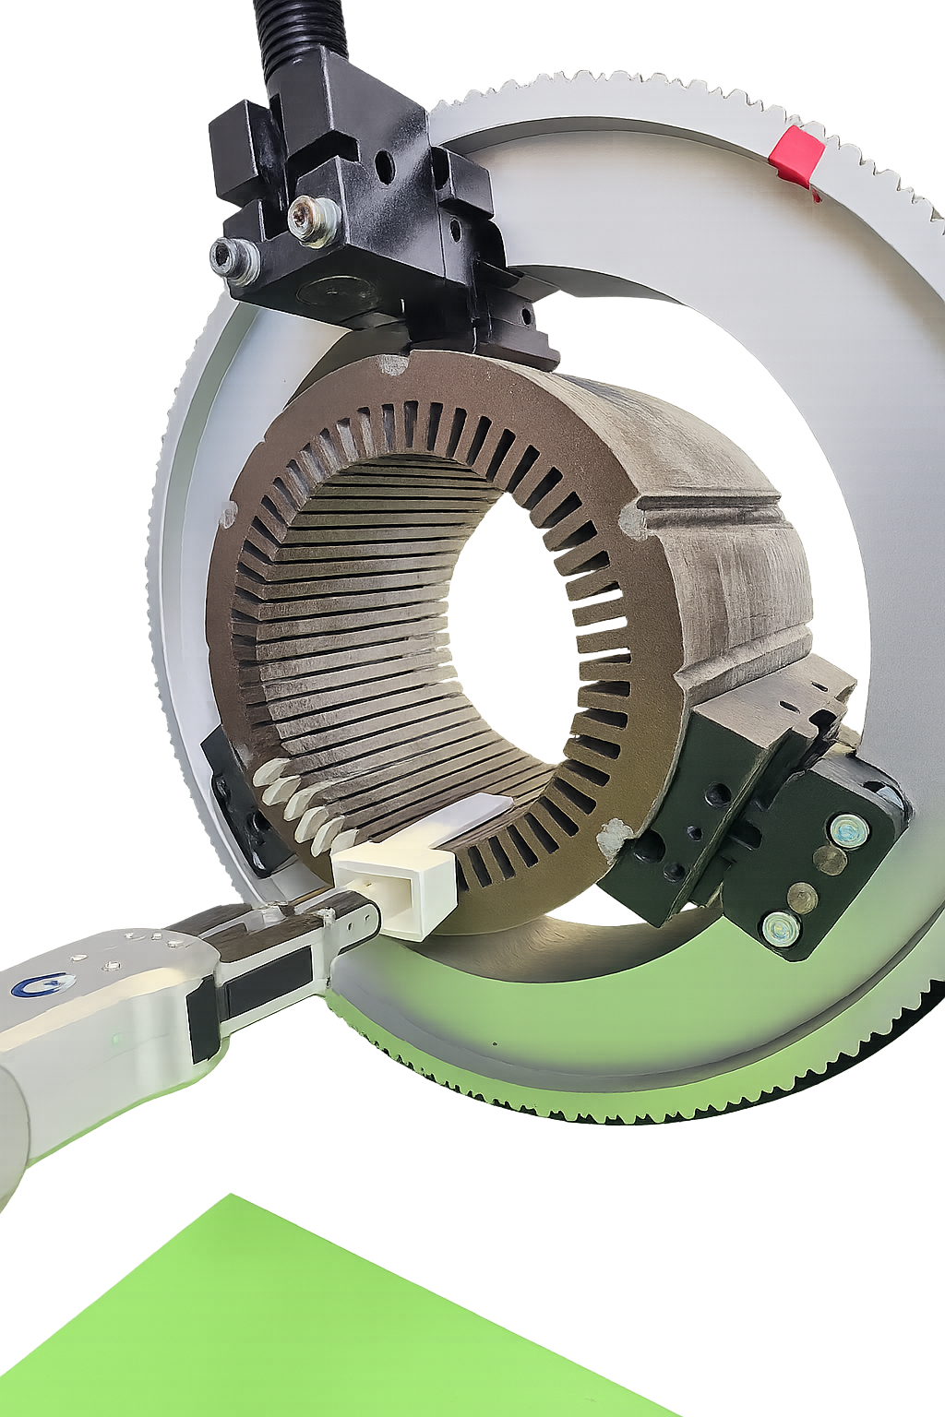
Introducing a parametric funnel designed to automate the insertion of slot liners efficiently and accurately.
Approach:
Parametric funnel adaptable to different stator configurations
Three key parameters can be adjusted for varying stator types
Integration of the funnel with a collaborative robot for complete automation
Expected benefits:
Increased precision and reliability
Reduced labour intensity
Flexibility for small-batch, high-variance manufacturing
Slot Liner
Parametric Funnel

Slide 10
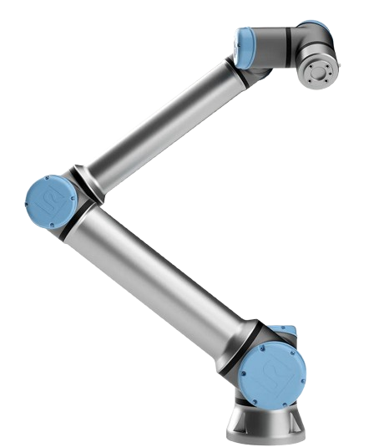
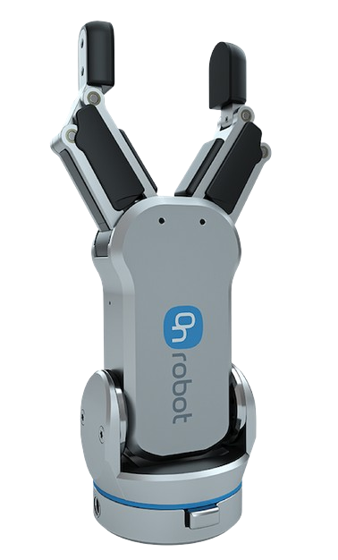
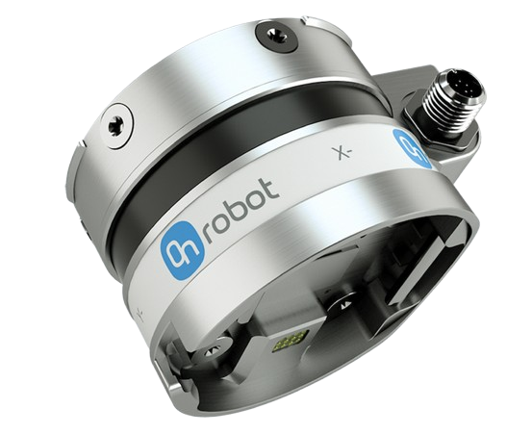
Robotic Module for Automated Insertion: UR10e Collaborative Robot, RG2 Gripper, and Force/Torque Sensor
UR10e Cobot:
Precise programmable motion 12.5 kg payload 1300 mm reach Compact and safe Easily adaptable for flexible manufacturing
RG2 Gripper:
Adjustable 2 finger gripper 110 mm stroke length Intelligent grip detection Customizable fingertips Suitable for secure handling of Slot Liners
HEX Force-Torque Sensor:
Real-time force monitoring 6 axis Force Torque measurement Ensures accurate insertion of liner Misalignment detection Configurable force thresholds
Source: UR robots [5], On robot [6]

Slide 11
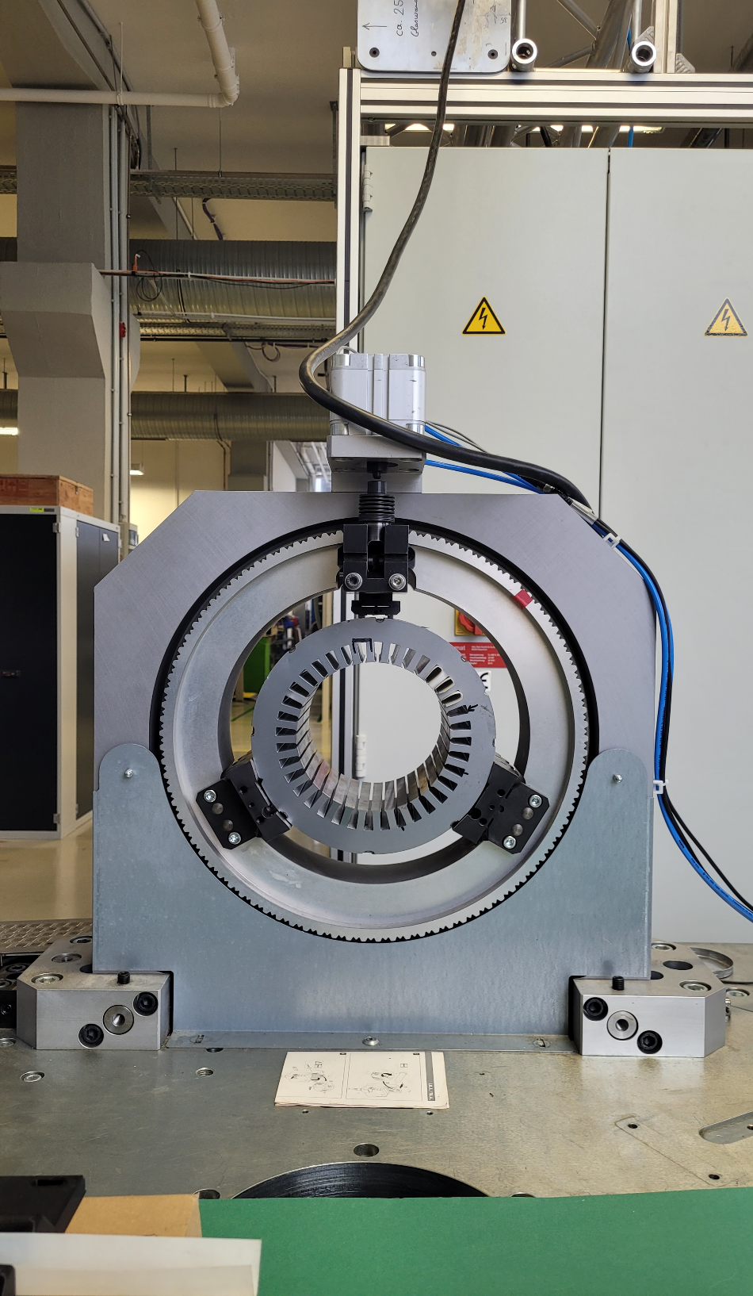
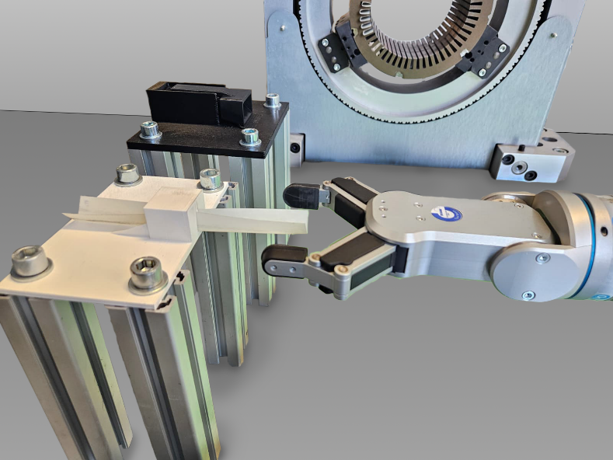
Mechanical fixtures were designed to ensure precise and reliable positioning of the stator, slot liner, and funnel throughout the assembly process.
Rotating Mechanical Clamp
1). Automatic Slot Alignment: User-defined rotation ensures perfect alignment of each slot for insertion. 2). Servo Motor + Siemens S7-1500 PLC - Provides precise, deterministic low-level motion control. 3). Manual origin calibration, stop-rotation function for safety, collision avoidance, and adaptability
Slot Liner and Funnel Positioning Platforms
1). Secure, repeatable positioning for insertion tool and slot liners 2). Quickly accommodates different funnel or slot liner geometries with minimal downtime. 3). Ensures accurate robot grasping, reducing misalignment and improving repeatability. 4). Enhances workflow efficiency in small-batch or high-mix production while maintaining precision.

Slide 12
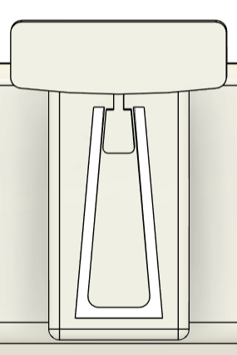
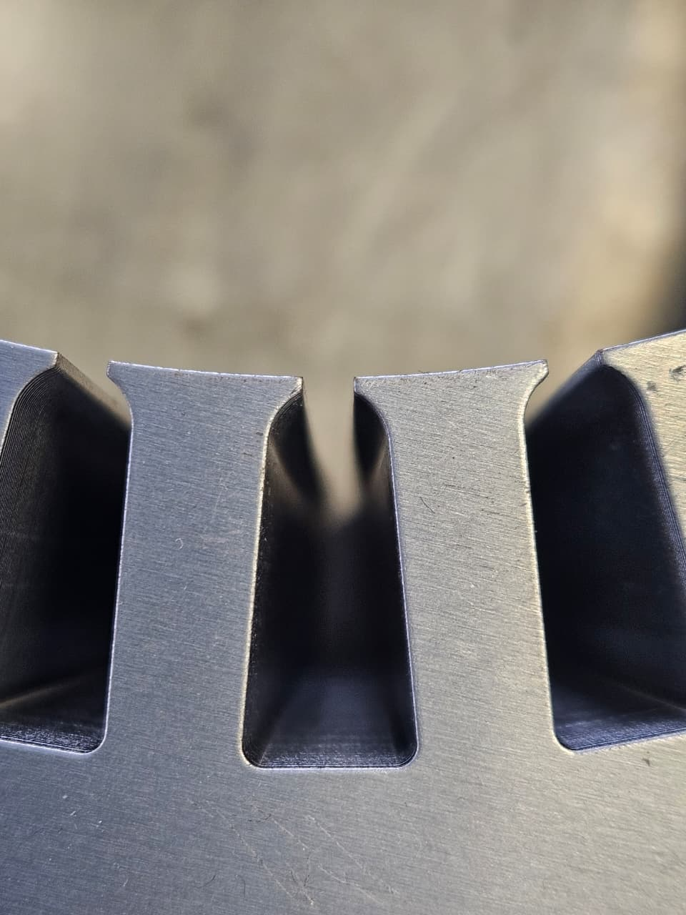
Three key parameters for the parametric funnel were chosen to allow adaptation to different stator geometries.
Slot Height
Slot Angle
Slot Width
a) tool parameters
b) Actual slot in a stator

Slide 13
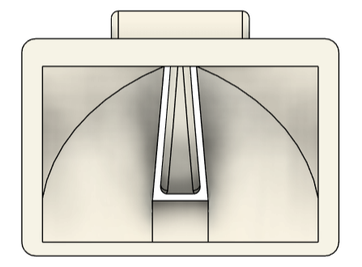
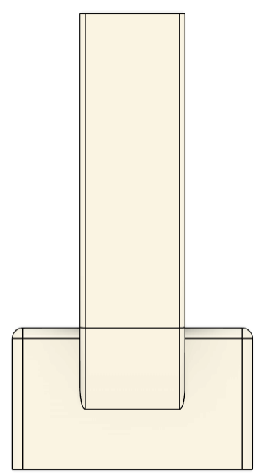
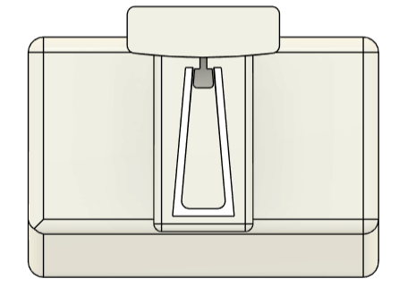
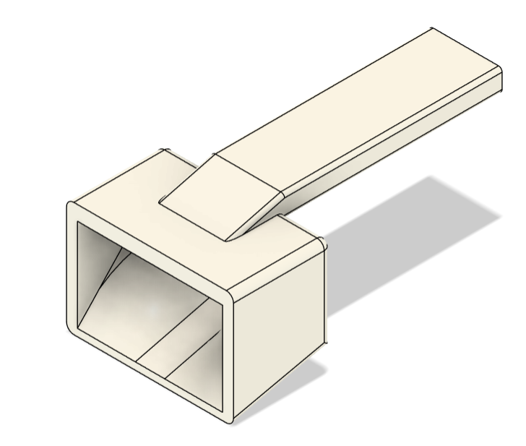
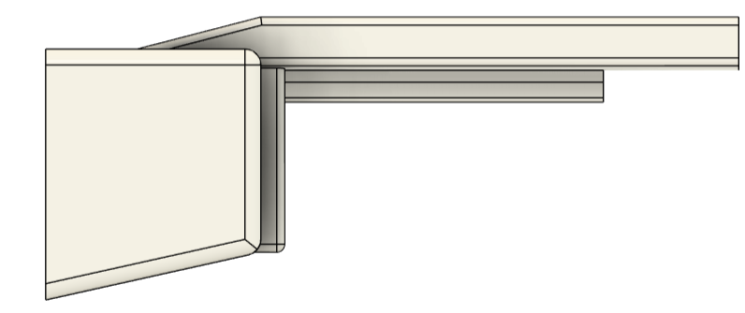
The funnel design incorporates several key features and design considerations aimed at ensuring optimal alignment, stability, and compatibility with stators of varying geometries.
Simplified guiding system: Replaced three rails with a single elongated rail featuring grooves for mechanical locking and easier insertion.
Improved stability: Extended and thickened tail (by 80 mm) to shift the center of gravity rearward and prevent forward tilting.
a) Front view
b) Rear view
Refined outlet geometry: Slightly undersized outlet (2–3%) ensures smooth liner entry without edge damage.
c) Top view
Enhanced adaptability: Simplified overall geometry for easier parametric adjustments and faster design modifications.
d) Side view
e) Isometric view

Slide 14
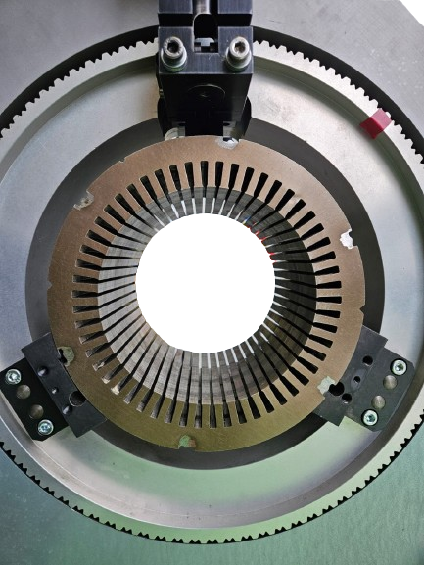
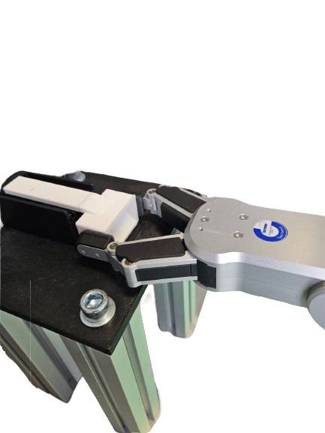
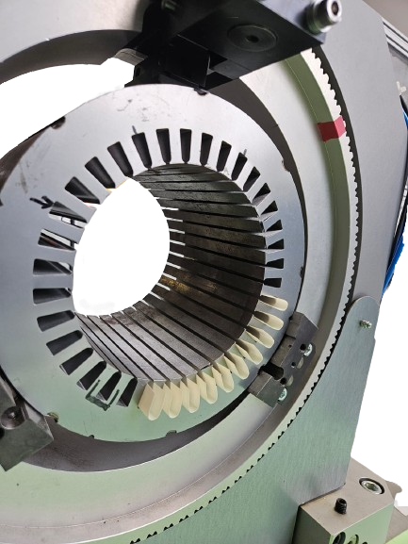
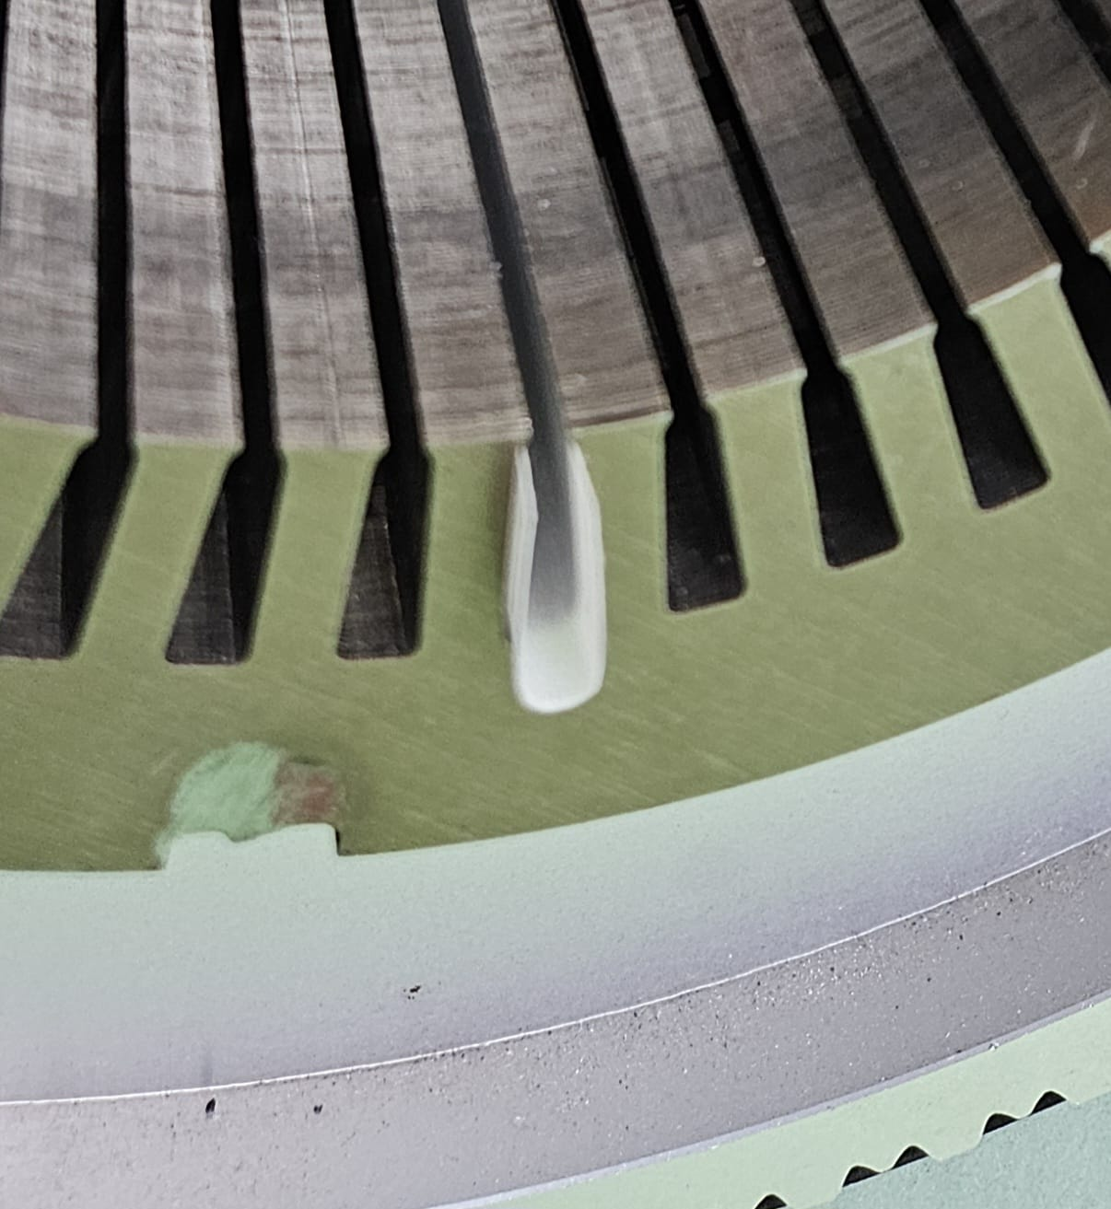
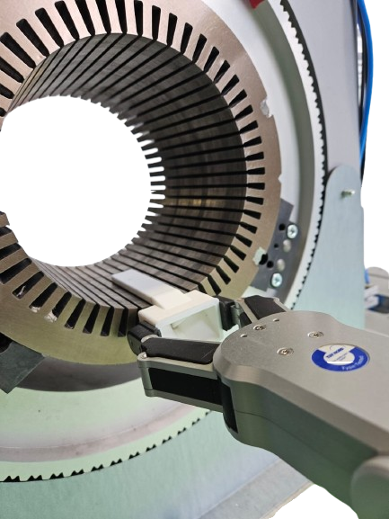
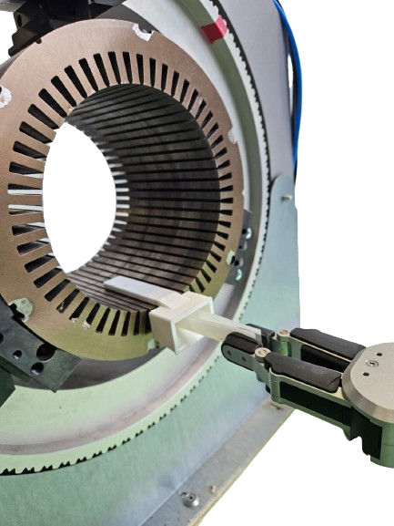
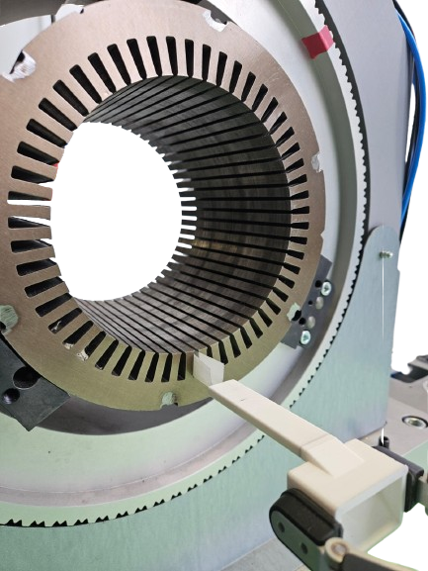
Automation Process of Slot Liner Insertion with the Proposed Parametric Funnel:
Picking Funnel from the platform
Insertion Completed
Stator without slot liner insulation
Stator with insulation
Funnel Insertion
Slot Liner Insertion
Pushing the slot liner into the stator
Process iterated till n == number of slots

Slide 15
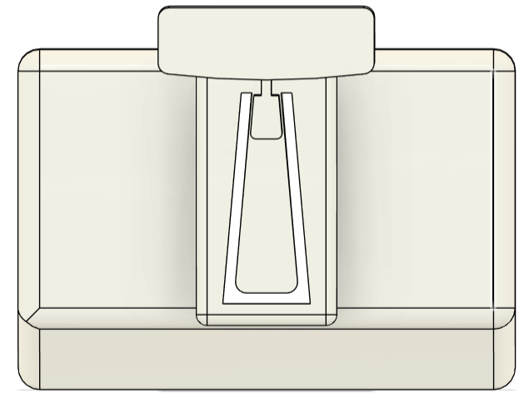
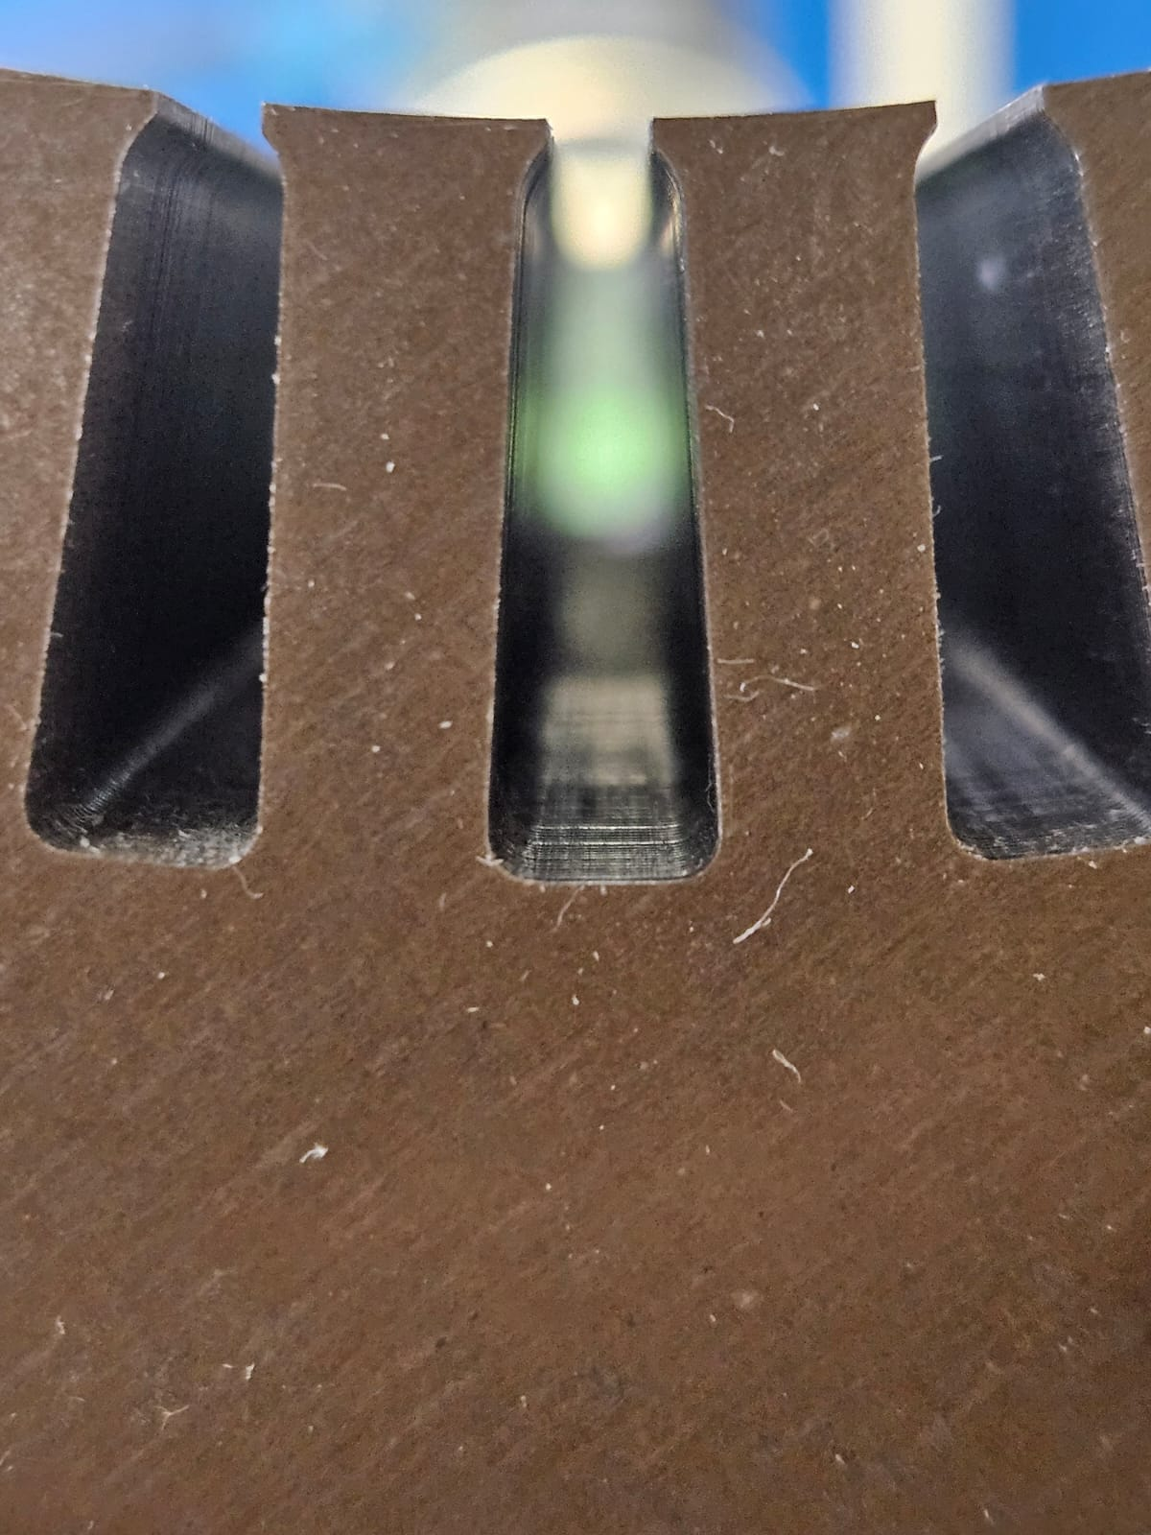
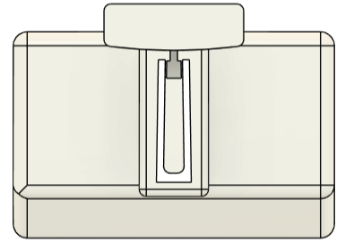
Funnel validation through evaluation using stators of varying geometries, designated as Stator A, Stator B, and Stator C
Slot Height – 20 mm
Slot Width – 8 mm
Slot angle – 85 deg
Slot Height – 19.8 mm
Slot Width – 8 mm
Slot angle – 85 deg
Stator A
Funnel A
Slot Height – 22 mm
Slot Width – 8 mm
Slot angle – 85 deg
Slot Height – 21.80 mm
Slot Width – 8 mm
Slot angle – 85 deg
Stator B
Funnel B
Slot Height – 18 mm
Slot Width – 5 mm
Slot angle – 89 deg
Slot Height – 17.80 mm
Slot Width – 5 mm
Slot angle – 89 deg
Stator C
Funnel C

Slide 16
Performance evaluation based on the success rates obtained from the validation of all three stator geometries.
260 insertion trials were conducted across three stators (A:100, B:100, C:60) to evaluate reliability and repeatability.
Preliminary trials for Stators A & B identified issues and refined parameters; Stator C tested directly with optimized settings.
Detailed records of defects and failure modes provided critical data for further system improvement.
The parametric insertion setup delivers consistent, repeatable, and robust liner placement, achieving a 97% success rate for Stators A and B, and 100% for Stator C

Slide 17
Error analysis and corresponding mitigation measures derived from preliminary trials conducted on the three stator geometries.
Stator A: 8 errors observed (6 pull-back with funnel, 2 misplacement on platform); improvements included standardized gripper handling, deeper insertion with inner finger, and stepwise funnel retraction, raising success rate from 80% to 97%.
Stator B: 10 errors observed (9 improper insertion, 1 funnel misalignment); improvements included controlled folding for consistent liner profiles and optimized funnel/gripper handling, increasing success rate from 77% to 97%.
Stator C: No errors observed in 60 trials; process performed flawlessly using optimizations from A & B, achieving 100% success even with the most constrained slot geometry.

Slide 18
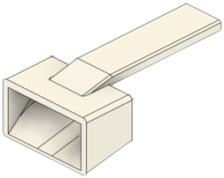
The results provide valuable insights and highlight areas where further improvements can be made to enhance the process and make it more relevant to industry applications.
The funnel is highly cost effective to produce, using about 30 g of PLA and costing under one euro.
Adding vision-based systems and adaptive feedback can enable a fully autonomous system.
Average cycle time ~39.8 s, with room for improvement via motion optimization..
The process does not yet incorporate automated folding, creasing, or shaping of liners
Performance depends heavily on slot liner geometry
Integrating Slot Liner dispenser with the rotating clamp can reduce robot travel and reduce cycle time

Slide 19
References
[1] IEA (2025), Global electric car sales, 2014-2024, IEA, Paris. https://www.iea.org/data-and-statistics/charts/global-electric-car-sales-2014-2024, Licence: CC BY 4.0
[2] J. Kauppinen, "Redesigning the Coil End Insulation of Electrical Motor," Bachelor’s Thesis, Vaasan ammattikorkeakoulu University of Applied Sciences, Department of Mechanical and Production Engineering, Vaasa, Finland, 2014.
3} Nguyen, M. , Dario, S. , Malec, D. , Mary, D. , Cambronne, J. , Prunel, D. and Orgelet, J. (2017) Environmental Assessment and Dielectric Performances of the Secondary Electrical Insulation in Low Voltage Motors Impregnated by Different Techniques. Engineering, 9, 860-873. doi:10.4236/eng.2017.910051
[4] GMW Taiwan, GMW CS-2B Stator Slot Cell Inserter. [Online]. Available: https://​www.gmwtaiwan.com​/​Slot-​Cell-​Insertion-​Machine/​GMW-​CS-​2B-​Stator-​Slot-​Cell-​Inserter
[5] Universal Robots, UR10e. [Online]. Available: https://​www.universal-robots.com​/​products/​ur10e
[6] OnRobot, RG2 Gripper - Flexible 2 Finger Robot Gripper | OnRobot. [Online]. Available: https://​onrobot.com​/​us/​products/​rg2-​gripper OnRobot, Hex 6-Axis Force Torque Sensor | OnRobot. [Online]. Available: https://​onrobot.com​/​en/​products/​hex-​6-​axis-​force-​torque-​sensor (accessed: Aug. 20 2025).

Slide 21
Questions?

